Slide 1
Lab Exercise 3
Augmenting the Thermal Conductivity of PCM Using CuO Nanoparticle

Slide 5
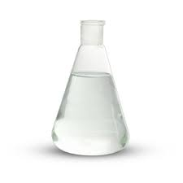
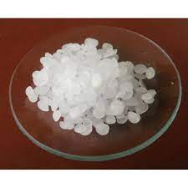
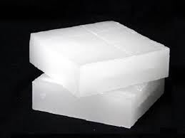
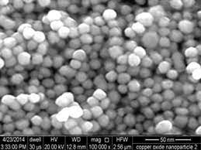
Augmenting the thermal conductivity of a Phase Change Material (PCM) Using Nanoparticle

Slide 6
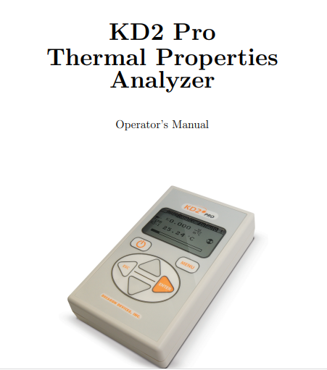
Thermal conductivity of PCM blended with CuO nanoparticle (Experimental)

Slide 7
Thermal conductivity of PCM blended with CuO nanoparticle (Analytical)
Solid
Maxwell Garnett Equation
Liquid
Bhattacharya et al Equation

Slide 8
Lab Exercise 3
Consider 16 observations (8 for solid state and 8 for liquid state) from the given dataframe. Perform the following using R Programming for analytical and experimental values,
Determine the grand mean, and mean of thermal conductivity.
Sum of Squares between and Sum of Squares within
Degrees of Freedom (Between, Within and total)
Mean Squares (Between and Within)
F_Statistic and F Critical
Check, Is Null hypothesize accepted?
Plot Vol. Concentration VS Thermal Conductivity
Plot Vol Concentration Vs % increase in Thermal conductivity –(In bar chart)
Error (Measured Value-Analytical Value)

Slide 9
Step1:
Setting the hypothesis (Null hypothesis or alternate hypothesis)
Null Hypothesis (H0: μ1=μ2=μ3)
Alternate Hypothesis (Ha: Alteast one difference among the means)
And
Fixing the confidence interval (90%, 95%)
α=0.1 or 0.05
Step2: Find the df
df between the groups/columns
df within the groups/columns
df_total

Slide 10
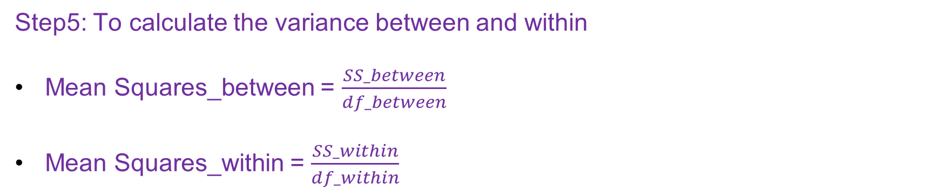
Step3:Calculating the Means
Means for each group and
Grand mean
Step4: All variability across the columns/groups
SST
SSC (Sum of Squares between/Columns)
SSE(Sum of Squares within/Errors)
Step5: To calculate the variance between and within
Mean Squares_between = $\frac{SS_between}{df_between}$
Mean Squares_within = $\frac{SS_within}{df_within}$
Step 6: To perform F test (To calculate F_ratio)
F_statistic = Mean Square_between / Mean Square_within
F_critical from F distribution table (Corr to df_numerator and df_denominator)

